Slide 1

High Cloud Airlines
Prepared by Rajan

Slide 2
Introduction
High Cloud Airlines is a airline operating a wide network of domestic and international routes.
With a strong focus on operational efficiency, customer satisfaction, and safety, the airline connects over 2,800 airports through more than 2.8 million annual flights.
High Cloud Airlines is committed to delivering reliable service, optimizing load factors, and enhancing the overall travel experience for its passengers.
As part of its growth strategy, the airline continually leverages data-driven insights to improve performance and make informed business decisions.

Slide 3
Business Objectives
Monitor overall airline performance
Identify trends in load factors, cancellations, and flight volumes
Evaluate top-performing routes and carriers
Reduce inefficiencies and improve operational strategies

Slide 4
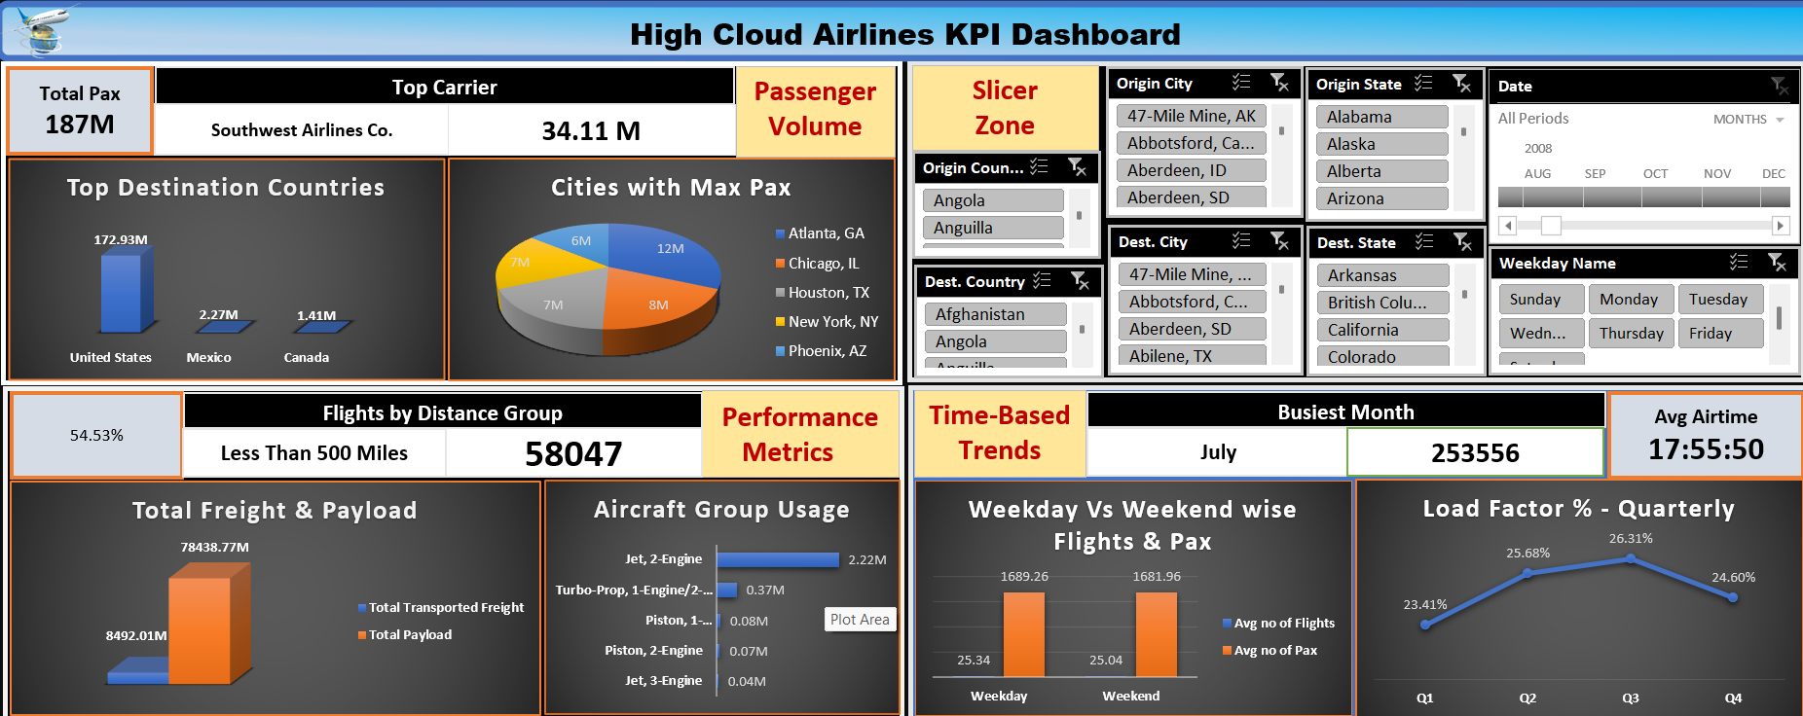

Slide 5
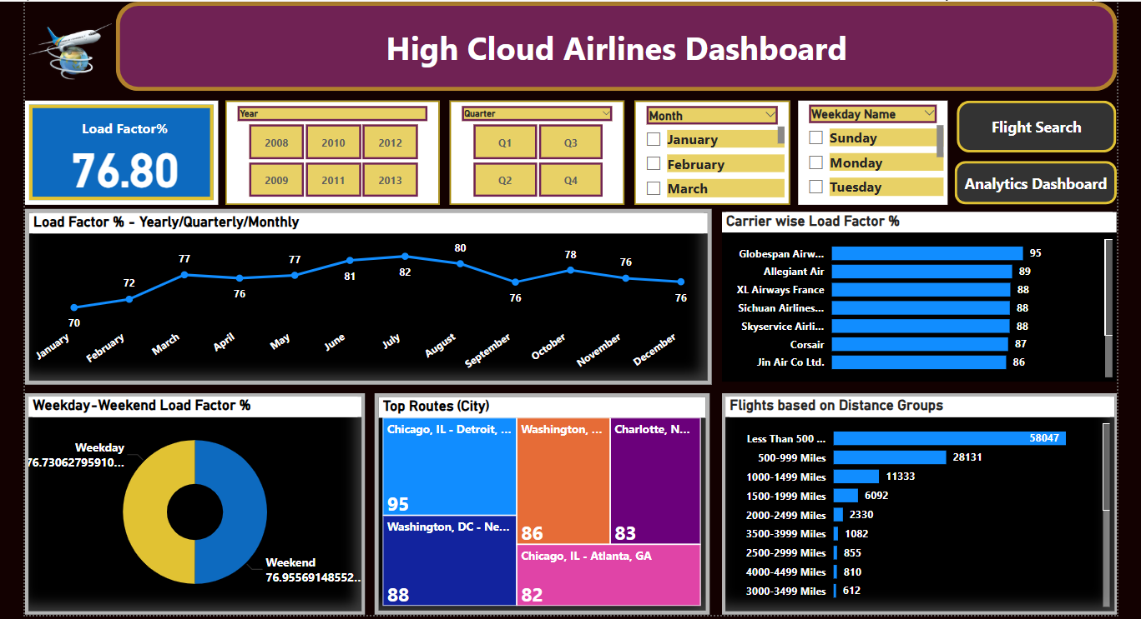

Slide 6
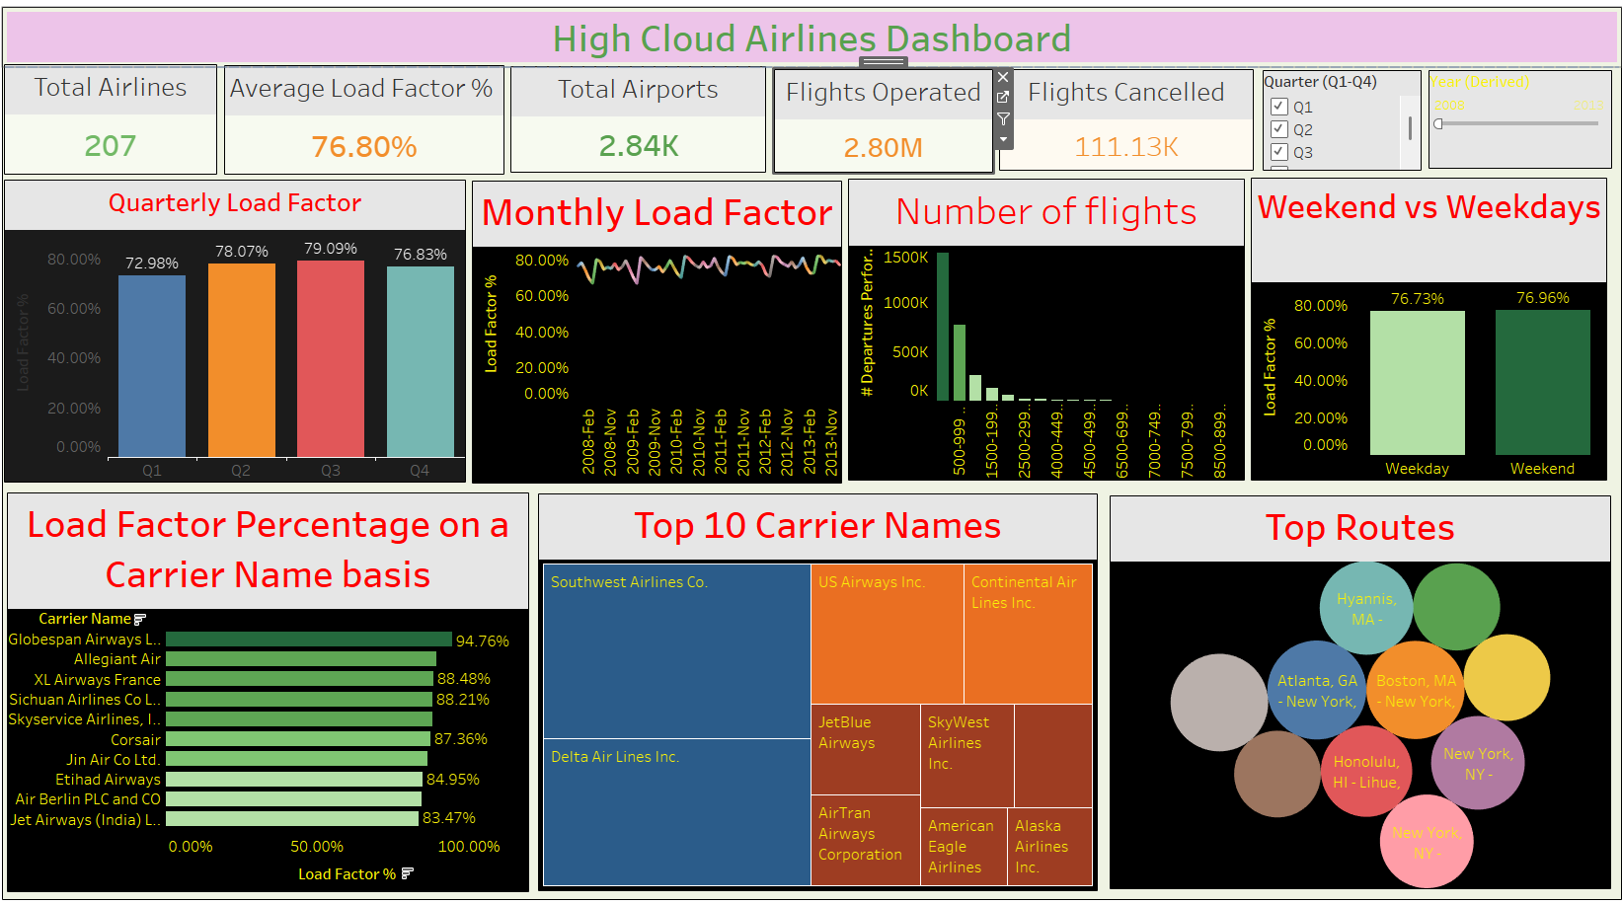

Slide 7
What is the Use of KPIs? Key Performance Indicators (KPIs) are essential metrics used to track and evaluate the performance of critical business activities. In the context of High Cloud Airlines, KPIs help to:
✔ Monitor operational efficiency and identify areas of improvement
✔ Make data-driven decisions to improve flight performance
✔ Track airline and route effectiveness over time
✔ Reduce cancellations and increase load factor (seat utilization)
✔ Support strategic planning and optimize resource allocation
Using KPIs ensures the airline maintains high service standards, competitive positioning, and long-term growth.

Slide 8
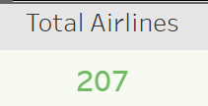
KPI: Total Airlines
Total Airlines: 207
Description: Represents the number of unique airlines covered in the dataset.
Problem: Too many airlines can make management harder. Some may not perform well.
Solution: Focus on top-performing airlines. Review low-performing ones regularly and simplify operations.

Slide 9
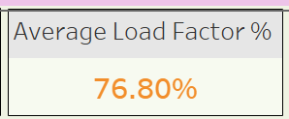
KPI: Average Load Factor
Value: 76.80%
What it shows: Average percentage of seats filled per flight.
Problem: Load factor is under 80%, showing some empty seats and lost revenue.
Solution: Improve marketing and pricing. Increase bookings on underutilized routes.

Slide 10
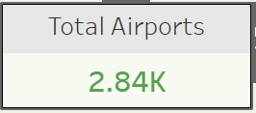
KPI: Total Airports
Value: 2.84K Airports
What it shows: Number of airports served by the airline.
Problem: Serving too many airports might include low-demand or unprofitable ones.
Solution: Review low-traffic airports. Focus on airports with higher demand and performance.

Slide 11
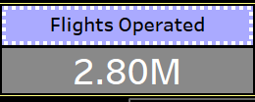
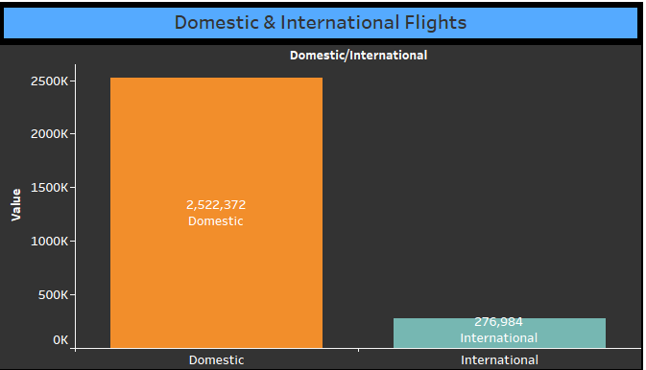
KPI: Flights Operated
Flights Operated: 2.80 Million
Description: Total number of flights that were successfully completed.
Insight: Domestic flights make up over 90% of total operations (2.52M out of 2.8M total flights).
Use Case: Optimizing domestic route efficiency can have the highest operational impact.
Solution: Focus investment on short-haul infrastructure, faster turnarounds, and regional partnerships.

Slide 12
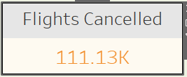
KPI: Flights Cancelled
Value: 111.13K Flights
What it shows: Total number of cancelled flights.
Problem: High cancellations can impact customer trust and revenue.
Solution: Analyze reasons for cancellations (weather, maintenance, etc.) and take preventive steps.

Slide 13
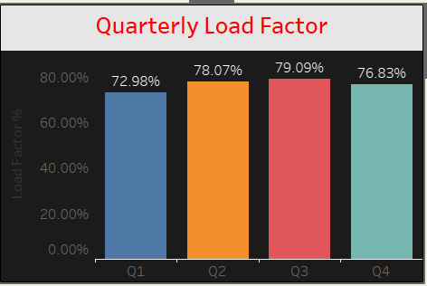
Quarterly Load Factor
Chart: Bar chart showing Load Factor % per quarter (Q1–Q4) Insight: Load factor remains consistent across all quarters, around 75–80%. Problem: No seasonal optimization observed. Same load factor year-round may indicate missed peak potential. Solution: Use seasonal pricing and targeted promotions to increase load factor in off-peak quarters.

Slide 14
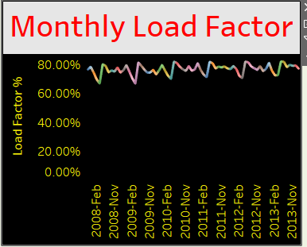
Monthly Load Factor Trend
Chart: Line chart showing monthly Load Factor % over several years Insight: Load factor is stable but shows little growth over time. Problem: Indicates stagnation in seat utilization efficiency. Solution: Improve marketing strategies and review route efficiency to boost load factors.

Slide 15
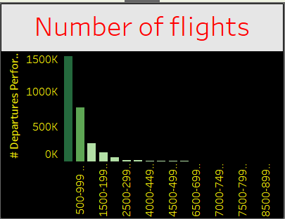
Flights by Distance
Chart: Bar chart showing flight count grouped by distance bands Insight: Majority of flights are in the 500–999 miles range. Problem: High volume of short-distance flights may be less profitable. Solution: Reassess short routes. Replace some with alternate transport options or bundle services.

Slide 16
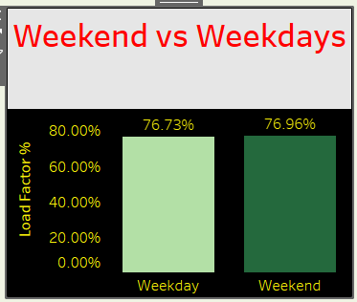
Weekend vs. Weekday Load Factor
Chart: Bar chart comparing weekend and weekday load factor Insight: Weekend load factor (76.96%) slightly higher than weekdays (76.73%). Problem: Not a major issue, but slight underutilization during weekdays. Solution: Offer weekday promotions or corporate packages to boost mid-week occupancy.

Slide 17
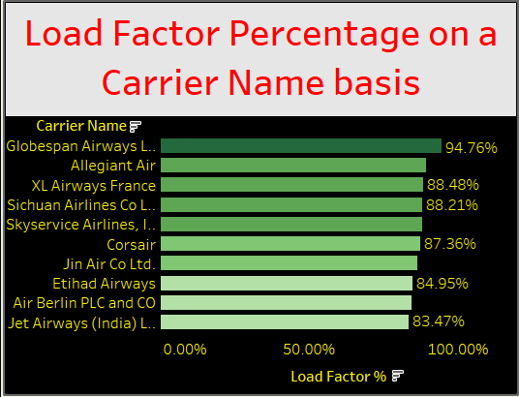
Load Factor by Carrier
Chart: Bar chart of top carriers by Load Factor % Insight: Globespan Airways leads with 94.76%, others like Allegiant and XL Airways also perform well. Problem: Not all airlines are equally efficient. Solution: Study practices of top carriers and share strategies across the network. Reduce reliance on low-performing carriers.

Slide 18
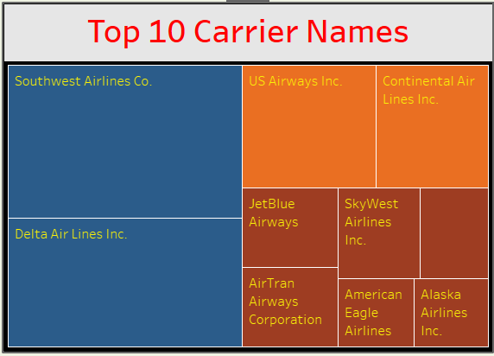
Top 10 Carriers (Treemap)
Chart: Treemap showing the top 10 airlines by size of operation Insight: Southwest, Delta, and US Airways are dominant carriers. Problem: Dependency on a few carriers could affect balance if one underperforms. Solution: Diversify operational load. Support mid-sized carriers to reduce risk.

Slide 19
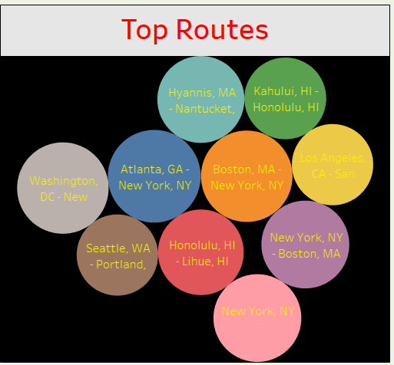
Top City Pair Routes
Chart: Each Bubble represents a city pair Route. Insight: Routes like Atlanta–New York and Boston–New York have high traffic. Problem: Overloaded routes may cause delays or resource stress. Solution: Add more flights during peak times or use larger aircraft to manage high demand.

Slide 20
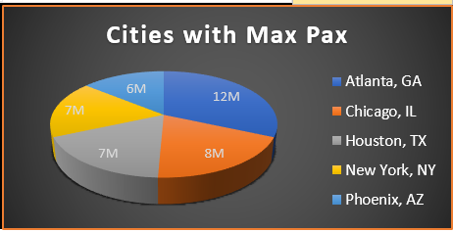
Passenger Traffic is Concentrated in a Few Cities
Insight: Cities like Atlanta, Chicago, and Houston contribute to a major portion of the total passenger traffic.
Use Case: Prioritize service quality and capacity planning in these high-demand areas.
Solution: Increase flight frequency or aircraft size on these key routes.

Slide 21
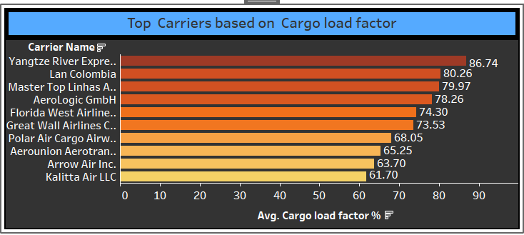
Cargo Load Factor Shows Underutilization
Insight: Most carriers operate at average cargo load factors below 80%, with top performers at 86.74%.
Use Case: There's potential to maximize revenue by optimizing unused cargo space.
Solution: Introduce smarter cargo allocation algorithms or real-time booking for freight.

Slide 22
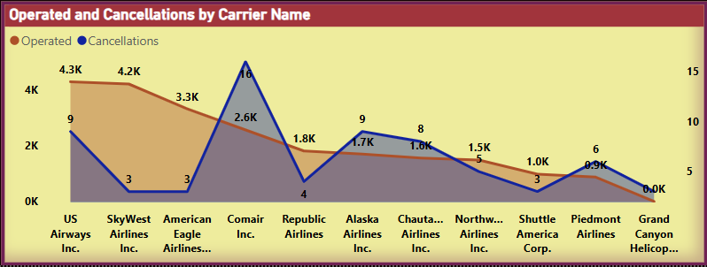
Operational Challenges: High Cancellations
Insight: Carriers like SkyWest and Comair have higher-than-average cancellations.
Use Case: Identify root causes (maintenance, staffing, weather, etc.) and improve on-time performance.
Solution: Real-time operations monitoring and predictive maintenance strategies.

Slide 23
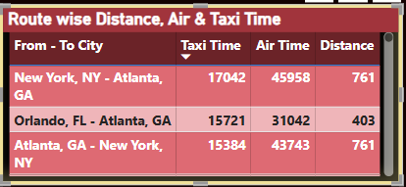
Taxi Time Significantly Impacts Total Duration
Insight: Some key routes show taxi times exceeding 17K seconds—up to 40% of total air time. Use Case: Impacts schedule reliability and increases airport congestion. Solution: Optimize gate assignments and ground operations at high-traffic airports.

Slide 24
Problems Identified
• Too many airlines (207) make management complex and may include low-performing carriers. • Average Load Factor is below 80%, leading to empty seats and lost revenue. • High number of airports (2.84K) includes some low-demand, less profitable ones. • Flights operated include many short routes (500–999 miles), which may be low margin. • Flight cancellations (111K+) affect customer satisfaction and reliability. • Load factor shows no seasonal adjustment across quarters or months. • Weekday load factor slightly lower than weekends – missed revenue opportunity. • Overdependence on a few carriers and city routes like New York and Atlanta could pose risks.

Slide 25
Suggested Solutions
• Focus on high-performing airlines and optimize partnerships. • Improve pricing and promotions to increase seat occupancy. • Review and reduce service to low-demand airports. • Track and minimize cancellations by analyzing causes (weather, operations, etc.). • Apply seasonal strategies to optimize quarterly load factor. • Launch weekday promotions to increase mid-week travel. • Balance dependency by supporting mid-tier carriers and expanding secondary routes.
• Operational inefficiencies such as long taxi times at major hubs highlight the need for process improvement on the ground.
• With targeted operational adjustments and data-driven planning, the airline can improve efficiency, reduce delays, and enhance overall service quality.

Slide 26
Final Conclusion
High Cloud Airlines demonstrates a strong operational presence with wide reach and consistent load factors.
However, areas like seat utilization, flight cancellations, and dependency on select routes/carriers require attention.
By acting on the identified problems and implementing data-driven solutions, the airline can improve efficiency, profitability, and customer satisfaction.

